Slide 1
LIFE INSURANCE PORTAL
PROJECT SUBMITTED BY
NITHIN R - 727822TUAM032
SHYLENDRA PRABU R - 727822TUAM053
LOKESH KRISNA C – 727822TUAM027
KRITHIK SS – 727822TUAM023

Slide 2
INTRODUCTION
In the domain of life insurance, individuals often encounter challenges such as complex insurance options, confusing registration processes, and security concerns. To address these issues, we propose the creation of an online life insurance portal. This system will provide clear information on different insurance plans, simplify the registration process, and implement robust security protocols, ensuring a user-friendly and secure experience for all users.
The primary objective of this project is to develop an online life insurance portal that offers users a user-friendly and secure platform to explore, select, and manage their insurance plans conveniently. By eliminating the complexities of traditional insurance methods and providing streamlined processes, the system aims to enhance user satisfaction and improve the overall efficiency of managing life insurance for all users.

Slide 3
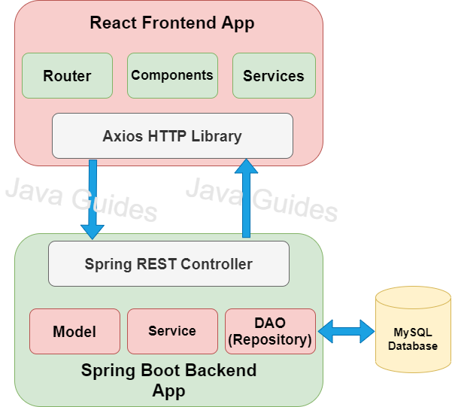
SYSTEM SPECIFICATION

Slide 4
FRONT END
The life insurance portal's front-end is built using React.js for a dynamic and modular user interface, allowing for reusable components and efficient state management.
React Icons were integrated to provide a consistent and customizable visual experience with scalable vector icons.
React Router facilitates smooth navigation, enhancing the overall user experience.
The portal incorporates interactive elements and real-time feedback, making the interface engaging and responsive. Secure local storage is used to maintain session state and protect user data.

Slide 5
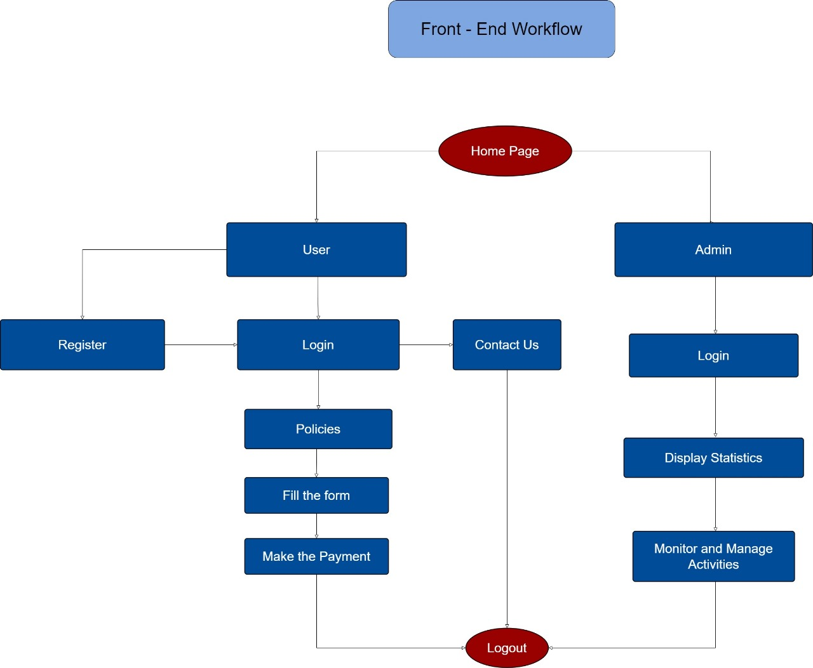
FRONT END WORK FLOW

Slide 6
BACK END
For the life insurance portal, the back-end was architected with Spring Boot, providing a strong and scalable structure.
User data, policies, and transactions are managed through a MySQL database. Postman was utilized for API testing, ensuring smooth and reliable server-client communication.
JWT (JSON Web Token) was employed for secure authentication, safeguarding user data throughout the portal.

Slide 7
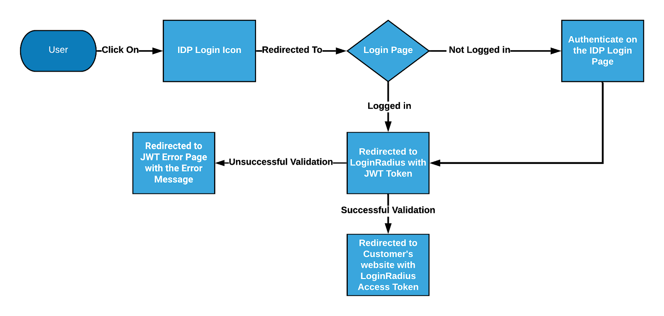
HOW JWT WORKS

Slide 8
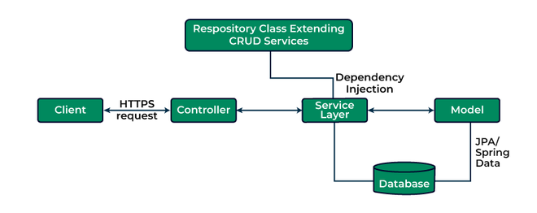
BACKEND WORK FLOW

Slide 9
INTEGRATION
For the life insurance portal, Axios was employed to integrate the React-based front-end with the Spring Boot back-end.
Axios manages HTTP requests, enabling the front-end to interact with back-end APIs for tasks such as user authentication, retrieving policy details, and submitting insurance applications.
This effective integration ensures smooth data exchange and an intuitive user experience across the portal.

Slide 10
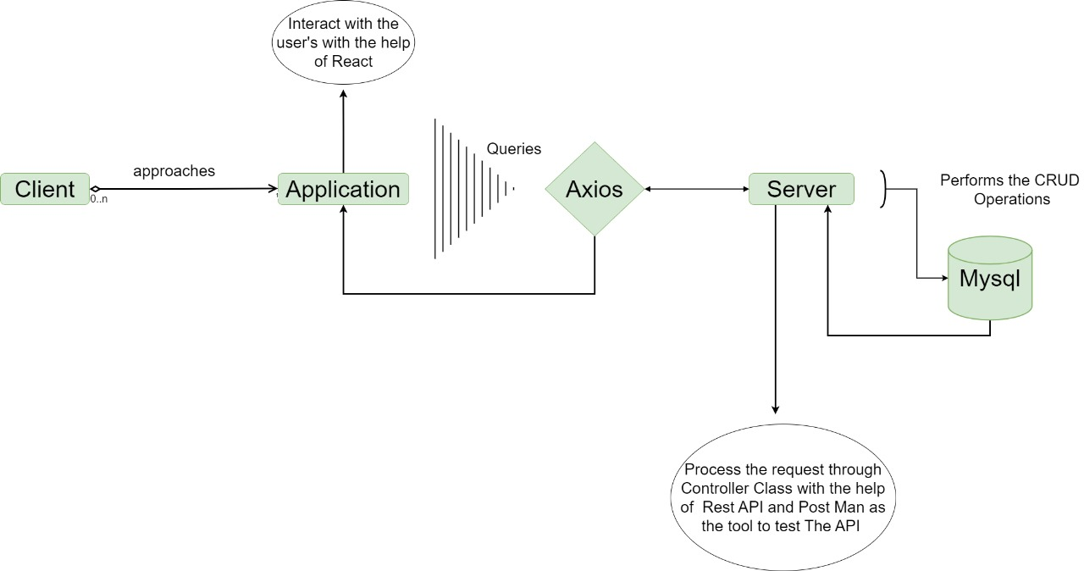
INTEGRATION WORK FLOW

Slide 11
CONCLUSION
The life insurance portal, built with React.js for the front end, Spring Boot for the back end, and Axios for API communication, offers a modern and scalable solution for today's digital insurance market.
React.js ensures a dynamic and responsive user interface with reusable components, enhancing development efficiency and user experience.
Spring Boot provides a robust and scalable back-end, supporting key features such as authentication and transaction management.
Axios facilitates smooth and secure data exchange between the front end and back end, ensuring a responsive and efficient application.

Slide 12
THANK YOU

